Slide 1
What is a render?
React · Lecture 4
React calls your component function again
function Counter() {
Console
console.log('render');
render
const [count, setCount] = useState(0);
return (
render
<button onClick={() => setCount(count + 1)}>
{count}
render
</button>
);
}
1
Notes:
Open the Counter from Lecture 3. Add console.log('render') live, at the top of the function. Click the button two times and point at the console: one "render" for the first draw, then one per click. Key sentence: a re-render means React calls your function again. A state change is what starts it.

Slide 2

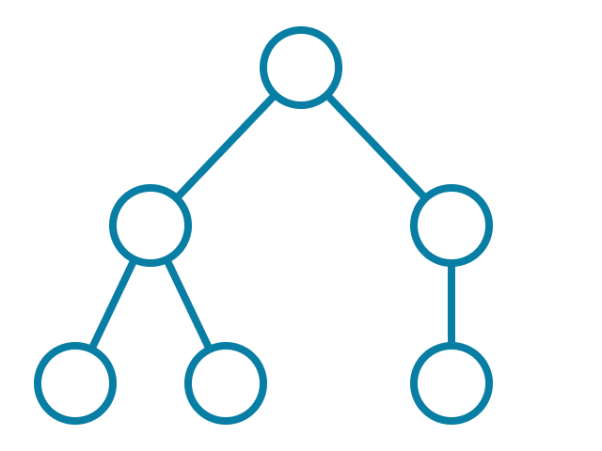
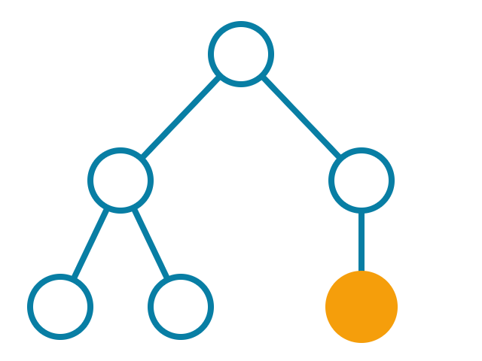


Virtual DOM
React · Lecture 4
Compare two plans. Change only the difference.
before
after
Real DOM:
update 1 node
2
Notes:
React does not change the page directly. It keeps a plan of the page as JS objects: the Virtual DOM. After a state change, React makes a new plan and compares it with the old one. Only the difference goes to the real DOM — here, one node. Changing the real DOM is slow; comparing JS objects is fast.

Slide 3

Why keys matter
React · Lecture 4
Stable keys help React match items
✘ key = index
✔ key = id
before
after
before
after
0 A
0 A
id1 A
id1 A
1 B
1 C
id2 B
id3 C
2 C
id3 C
3
Notes:
Keys tell React which item is which between two renders. We delete B. With key = index, C gets key 1 — the old key of B — so React gives C the row and state of B, and thinks C was deleted. With key = id, React matches A to A and C to C. Demo: a list with an input in each row and key={index}. Type in row B, delete B: the text jumps to the wrong row. Switch to key={item.id}: fixed. Rule: use a stable id when items can move or be deleted.

Slide 4



A component's life
React · Lecture 4
Mount
Update
Unmount
4
Notes:
Every component has a life. Mount: it appears on the screen for the first time. Update: it re-renders — this can happen many times. Unmount: it is removed from the screen. Like a window: you open it, you edit it, you close it. useEffect lets us run code at each of these moments.

Slide 5




Side effects
React · Lecture 4
Anything that reaches outside the component
Timer
Tab title
Storage
API
5
Notes:
Rendering only calculates JSX from props and state. Everything else goes in an effect. A side effect touches the world outside the component: a timer (setInterval), the browser tab title (document.title), storage (localStorage), the network (fetch to an API).

Slide 6
useEffect
React · Lecture 4
useEffect(() => {
document.title = 'Clicked ' + count + ' times';
}, [count]);
Run this after rendering
6
Notes:
useEffect takes a function. React runs it after the render, when the screen is already drawn. Live: add this to the Counter and click — watch the browser tab title change. The [count] at the end means "run again when count changes". That is the next slide.

Slide 7
The dependency array
React · Lecture 4
useEffect(fn)
→
after every render
useEffect(fn, [])
→
once, on mount
useEffect(fn, [x])
→
when x changes
7
Notes:
The most important slide today. Read each row slowly. No array: the effect runs after every render. Empty array: once, when the component mounts. [x]: on mount, and again every time x changes. Quiz her: cover the right column and ask "When does this run?" Then ask in a mixed order, and the other way round ("I want it once — what do I write?"). Repeat until she answers fast.

Slide 8
Cleanup
React · Lecture 4
useEffect(() => {
const id = setInterval(tick, 1000);
return () => clearInterval(id);
}, []);
Clean up before you leave
8
Notes:
An effect can return a function: the cleanup. React runs it before the component unmounts, and before the effect runs again. Demo: the timer without the return line. Show and hide the component a few times — the timer gets faster, because the old intervals are still running. Add the return line and repeat: fixed.

Slide 9


Common traps
React · Lecture 4
Infinite loop
Runs twice in development?
setState in an effect with no array
That's StrictMode. Normal.
9
Notes:
Show both live so she recognizes them. 1) setState inside an effect with no array: render → effect → setState → render → … forever. The page freezes. Fix: add the dependency array. 2) In development, StrictMode mounts, unmounts and mounts again, so effects run twice. This is on purpose: it helps find missing cleanups. It does not happen in production.

Slide 10
useRef (concept)
React · Lecture 4
A box that survives renders and doesn't cause them
const inputRef = useRef(null);
<input ref={inputRef} />
inputRef.current.focus();
10
Notes:
Demo only, keep it short. useRef gives you a box: an object with .current. The box keeps its value between renders. Unlike state, changing a ref doesn't update the screen — no re-render. Most common use: get a DOM element, for example to focus an input. Show a "Focus" button that calls inputRef.current.focus(), then move on.

Slide 11


Homework
React · Lecture 4
Effects practice
Save the shopping list to localStorage
Window width component
Resize listener + cleanup
11
Notes:
1) Take the shopping list from Lecture 3. Save it to localStorage in an effect when the list changes, and load it when the app starts. 2) Make a component that shows the window width (window.innerWidth). 3) Update it with a resize listener added in an effect — and remove the listener in the cleanup. Remind her: effects running twice in the console is StrictMode, and it is normal.

